Slide 1
CS 370 Introduction to Security
Software Attacks

Slide 2
Topics For Today
Compiler tools to detect/prevent software vulnerabilities
How to disclose software vulnerabilities
Responsible disclosure of security vulnerabilities
Bug Bounty Program
Competitions (Pwn2Own)
Cyberweapons and possible attack scenarios

Slide 3


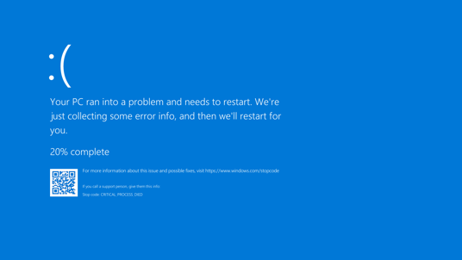

Software Vulnerabilities Recap
Modern software is complex
34M+ lines of code in Google Chrome
27M+ lines of code in Linux Kernel
25M+ lines of code in Android
Mistake happens

Slide 4
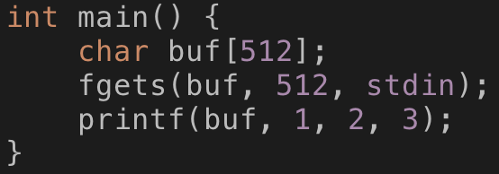
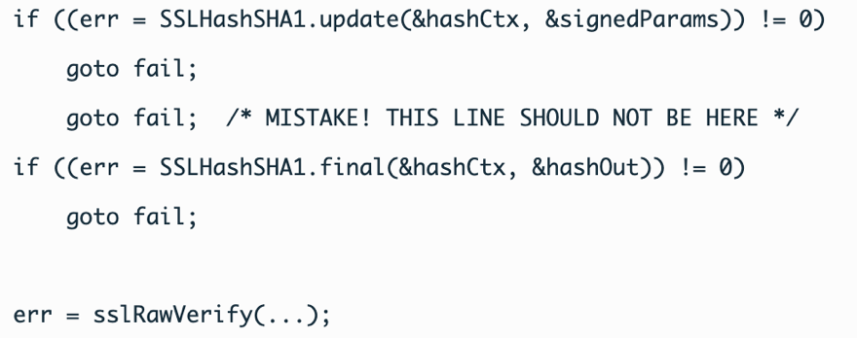
Software Vulnerabilities Recap
Buffer overflow vulnerabilities
char buf[100]; strcpy(buf, data);
Format String vulnerabilities
printf(buf); where buf = “%d %d %s %p %n …”
Use-after-free vulnerabilities
Object *o = new Object(); delete o; o->toString();
Other logic bugs
goto fail;
goto fail;

Slide 5
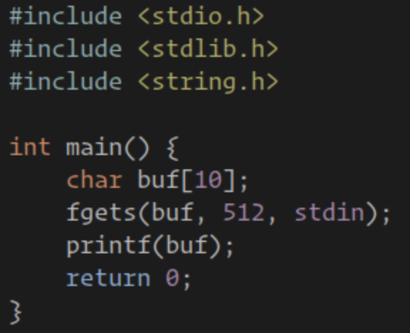
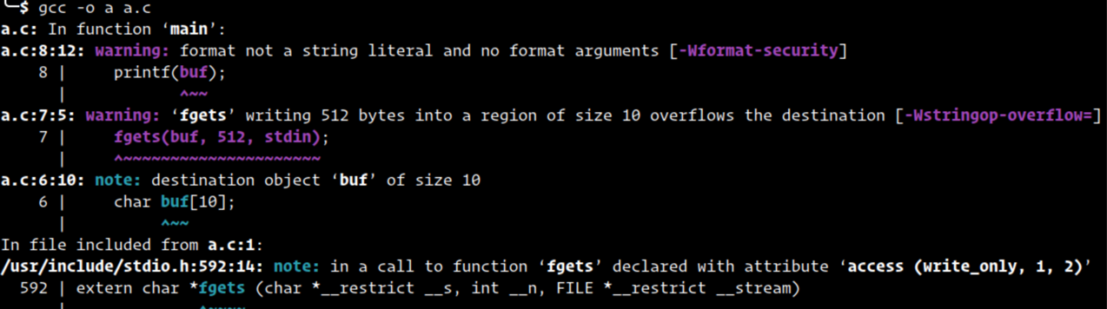
A Good Practice: Compiler Options
Don’t ignore compiler warnings in using C/C++

Slide 6
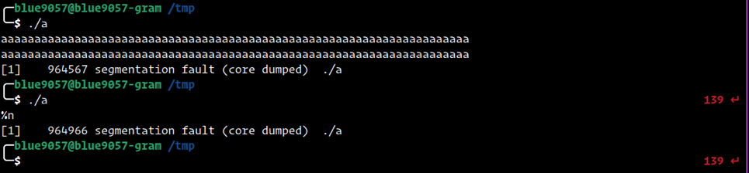
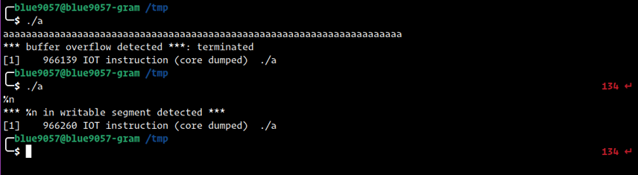
A Good Practice: Compiler Options
-O2 -D_FORTIFY_SOURCE=2
Prevent buffer overflow and format string attacks

Slide 7
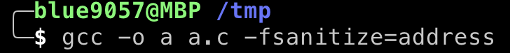
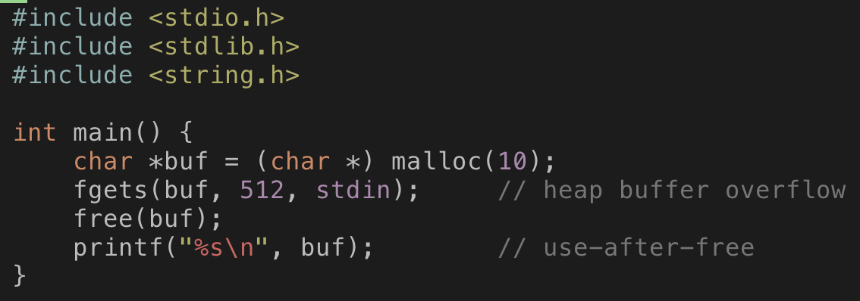
A Good Practice: Compiler Options
-fsanitize=address
Apply Address Sanitizer
https://github.com/google/sanitizers/wiki/AddressSanitizer

Slide 8
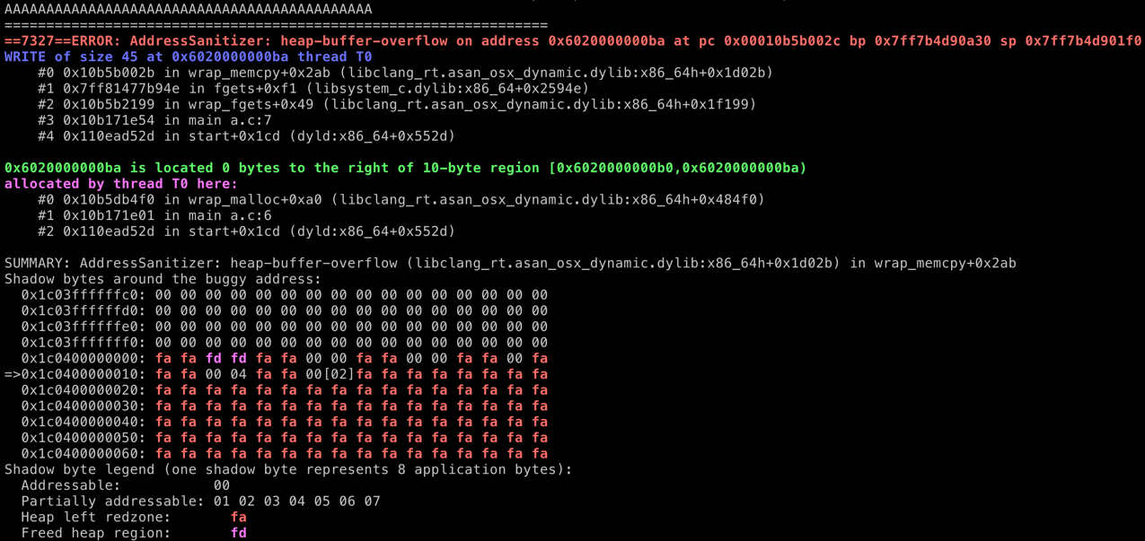
Address Sanitizer
Type AAAAAAAAAAAAAAAAAAA to trigger heap buffer overflow

Slide 9
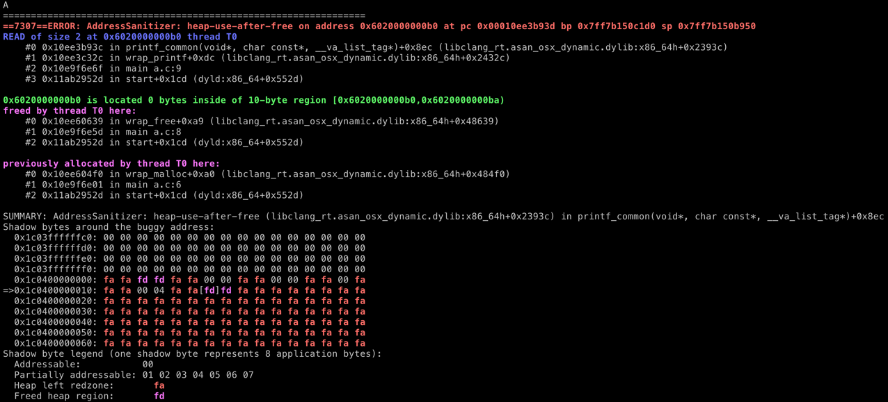
Address Sanitizer
Type A to trigger use-after-free bug

Slide 10
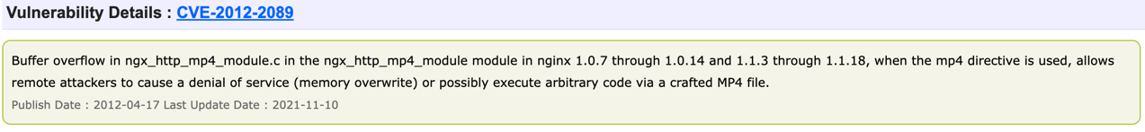
How CVE Works? (Recap)
Developers
Find vulnerabilities in their software (e.g., nginx v1.0.7 ~ 1.0.14 has a BOF)
Fix that
Announce that to CVE
System operators
Watch the CVE list and update vulnerable software

Slide 11
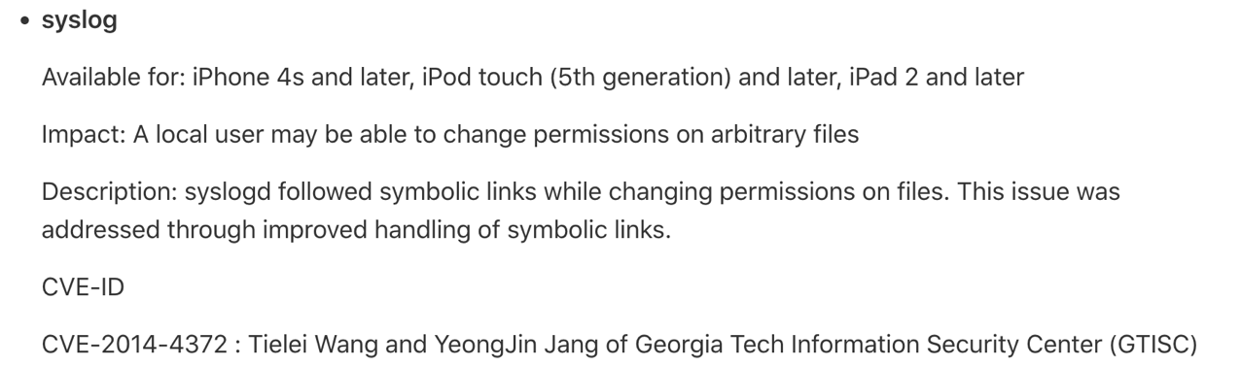
How CVE Works (Recap)
White Hat Hackers
Analyze software using testing methods
Fuzzing, symbolic execution, manual testing, code auditing, reverse engineering, etc
Find a bug
Exploit the bug
Vendor reports that to NIST/MITRE CVE

Slide 12

Vulnerability Disclosure is Important
A good model of vulnerability discovery/disclosure/patch cycle
1. A white hat hacker finds a vulnerability

Slide 13




Vulnerability Disclosure is Important
A good model of vulnerability discovery/disclosure/patch cycle
1. A white hat hacker finds a vulnerability
2. Let affected vendors know about the vulnerability;
Where in the code it is, why it happens,
and preferably with “how to fix it”

Slide 14
Vulnerability Disclosure is Important
A good model of vulnerability discovery/disclosure/patch cycle
1. A white hat hacker finds a vulnerability
2. Let affected vendors know about the vulnerability;
Where in the code it is, why it happens,
and preferably with “how to fix it”
3. Vendors start to fix the vulnerabilitie

Slide 15

Vulnerability Disclosure is Important
A good model of vulnerability discovery/disclosure/patch cycle
1. A white hat hacker finds a vulnerability
2. Let affected vendors know about the vulnerability;
Where in the code it is, why it happens,
and preferably with “how to fix it”
4. Wait until vendors fixing the vulnerability (90~180 days)
3. Vendors start to fix the vulnerability

Slide 16
Vulnerability Disclosure is Important
A good model of vulnerability discovery/disclosure/patch cycle
1. A white hat hacker finds a vulnerability
2. Let affected vendors know about the vulnerability;
Where in the code it is, why it happens,
and preferably with “how to fix it”
4. Wait until vendors fixing the vulnerability (90~180 days)
3. Vendors start to fix the vulnerability
5. The vulnerability has been fixed after 75 days..

Slide 17
Vulnerability Disclosure is Important
A good model of vulnerability discovery/disclosure/patch cycle
1. A white hat hacker finds a vulnerability
2. Let affected vendors know about the vulnerability;
Where in the code it is, why it happens,
and preferably with “how to fix it”
4. Wait until vendors fixing the vulnerability (90~180 days)
3. Vendors start to fix vulnerability
5. The vulnerability has been fixed after 75 days..
6. The hacker publishes their work (paper, presentation, open-source, etc.)

Slide 18
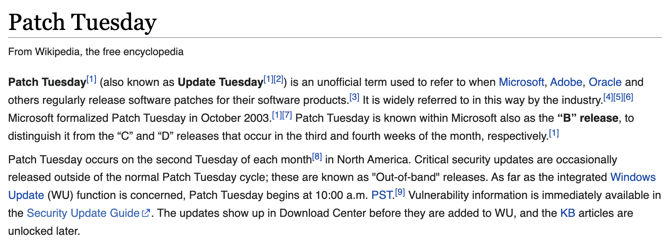
Report -> Patch -> CVE -> UPDATE
Vulnerability Patch Cycles
Vendor gets a secret report from researchers/hackers/developers/etc
Vendor fixes it, and release a patch
At the same time, archive the vulnerability in the CVE database
Users are running updates to be immune to the vulnerability

Slide 19
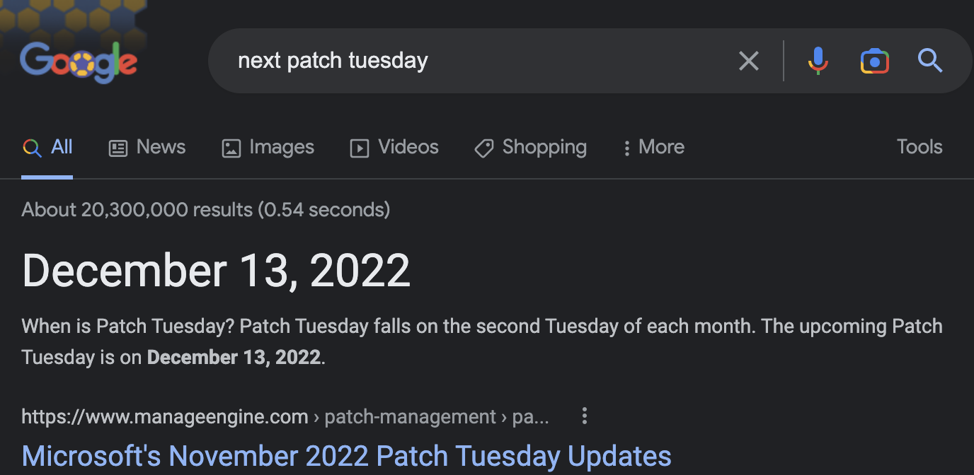
Report -> Patch -> CVE -> UPDATE
Vulnerability Patch Cycles
Vendor gets a secret report from researchers/hackers/developers/etc
Vendor fixes it, and release a patch
At the same time, archive the vulnerability in the CVE database
Users are running updates to be immune to the vulnerability

Slide 20
Responsible Vulnerability Disclosure
Zero-day vulnerabilities are dangerous
0-day vulns: vulnerabilities that do not have any patch yet
i.e., nobody other than who just discover the vulnerability knows about it
But we need to report/disclose vulnerabilities
For vendors to release software patches to fix them
For users to update them
Most importantly, we need to reduce the number of victims of the vulnerability disclosure
User software update takes time (do you update Windows right away on Tuesday??)
90~180 days are norm in these days

Slide 21

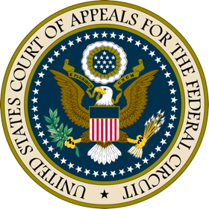

How to Report Vulnerabilities?
Contact to vendor directly
In old days
What..the…
Hackers are bad. Criminals!
Let’s call the police!!
Hey, I found a vuln in your product.
Here’s the detail and way to fix it, so please do so!
It’s free, just leaving my id, ‘blue9057’ for the credit.

Slide 22
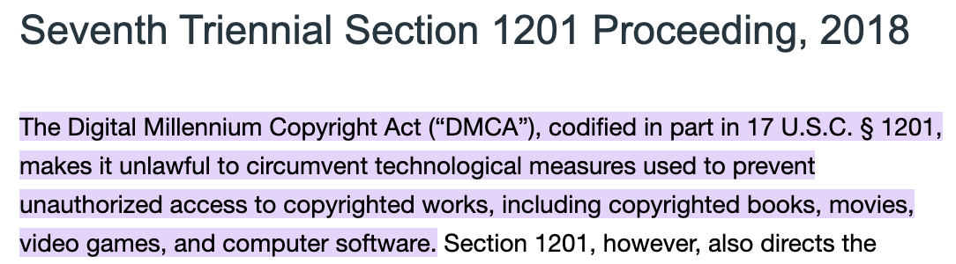
Why?
DMCA (Digital Millennium Copyright Act)
Enacted since 1998
Section 1201 of DMCA
Reverse engineering / hacking is prohibited by law

Slide 23

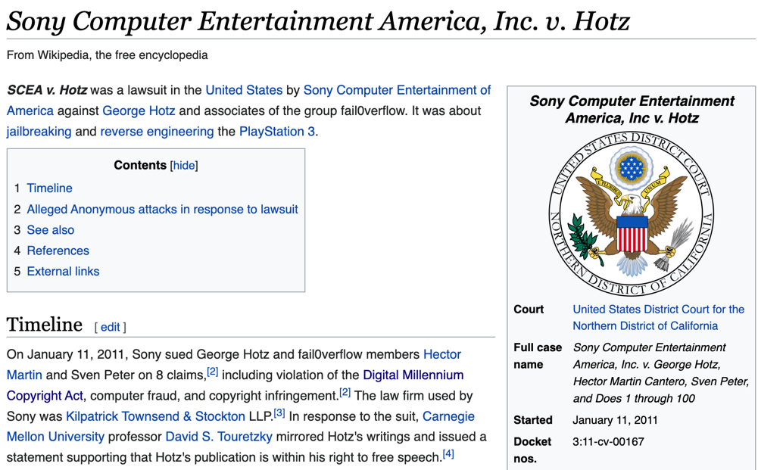
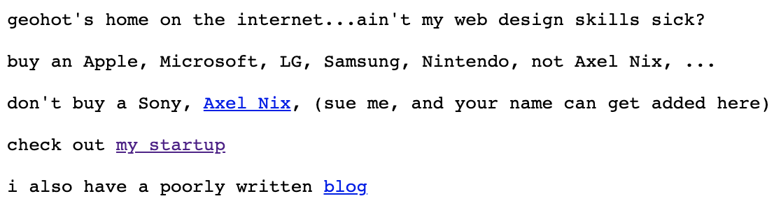
Sony vs Hotz
Geohot and others hacked Sony Playstation 3
A complete jailbreak
Let users install any OS/apps, do whatever with PS3
Leaked a private key

Slide 24
Lessons
Don’t do illegal stuff with computers
Even if you have a good will, you could get punished by jurisdiction
Releasing private key to public -> BAD
Release the exploit without having patch, let other users pirate apps
Yes, it is a crime
But DMCA could be too harsh to the security community
Reverse engineering the device that you own
Hack the device that you own, not harm any others
Attack the ‘test’ user account that you have created
All such could be punished by DMCA

Slide 25
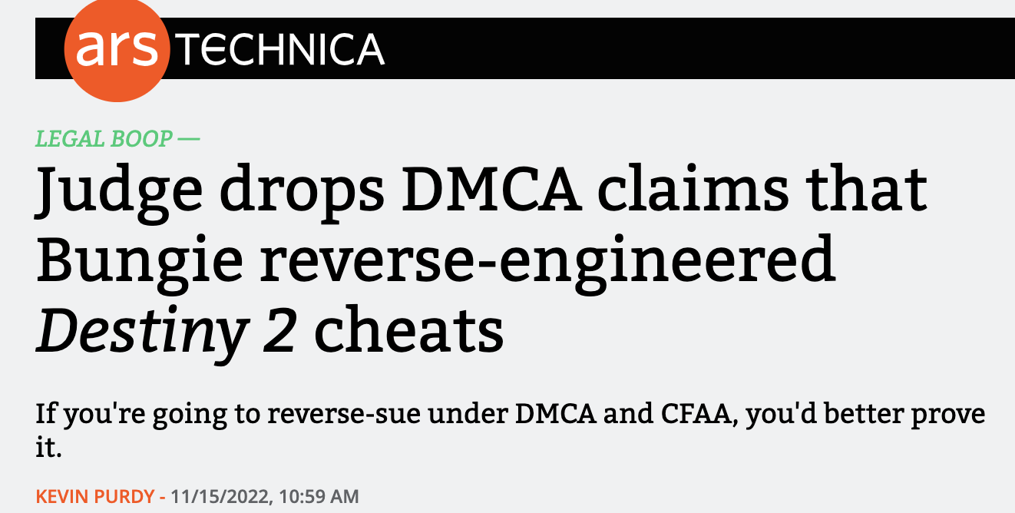
Lessons
Don’t do illegal stuff with computers
Even if you have a good will, you could get punished by jurisdiction
Releasing private key to public -> BAD
Release the exploit without having patch, let other users pirate apps
Yes, it is a crime
But DMCA could be too harsh to the security community
Reverse engineering the device that you own
Hack the device that you own, not harm any others
Attack the ‘test’ user account that you have created
All such could be punished by DMCA

Slide 26
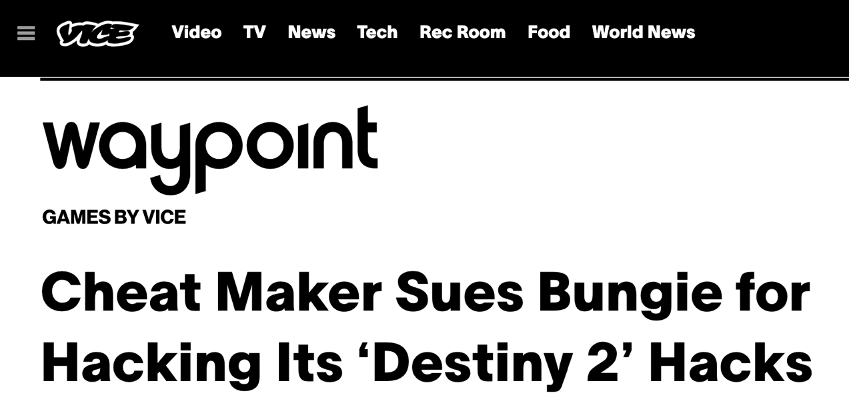
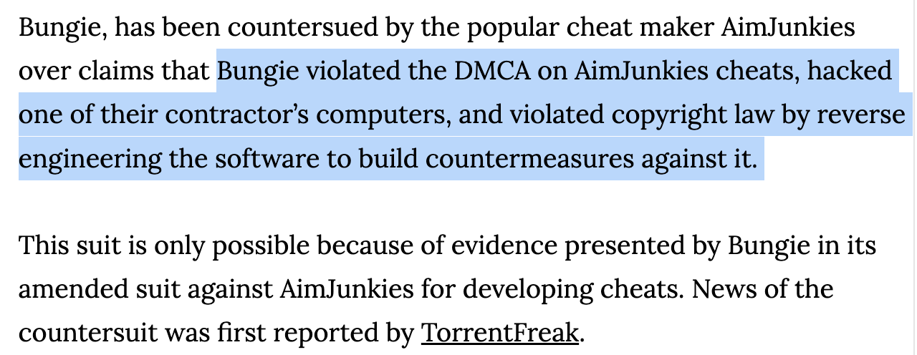
Lessons
Don’t do illegal stuff with computers
Even if you have a good will, you could get punished by jurisdiction
Releasing private key to public -> BAD
Release the exploit without having patch, let other users pirate apps
Yes, it is a crime
But DMCA could be too harsh to the security community
Reverse engineering the device that you own
Hack the device that you own, not harm any others
Attack the ‘test’ user account that you have created
All such could be punished by DMCA

Slide 27
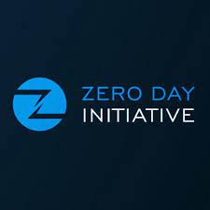
Then, How Can We Protect Ourselves from Lawsuit?
Coordinated Vulnerability Disclosure
There are companies that helps communication between
Hackers and vendors
The company offers full protection to the hackers
Anonymity of the submission, no lawsuit from the vendor, etc.
The company helps the vendor to fix the issue
The company gets compensation from the vendor
Pays back the hacker
No lawsuit, hacker gets $$$, vendor fixes vuln, all good!
How such a company earns $$$? Is the company blackmails the vendor? I don’t know…

Slide 28
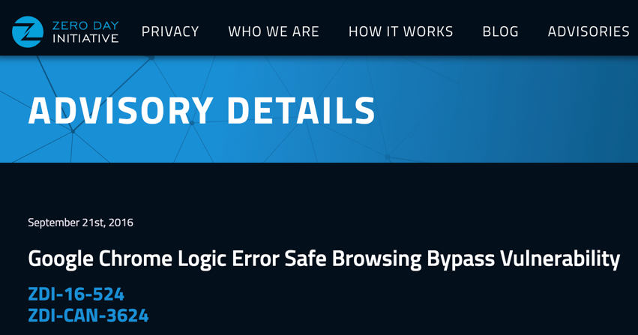
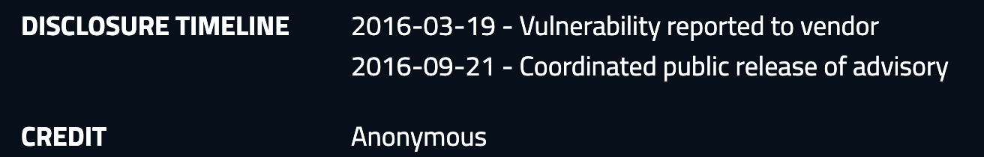
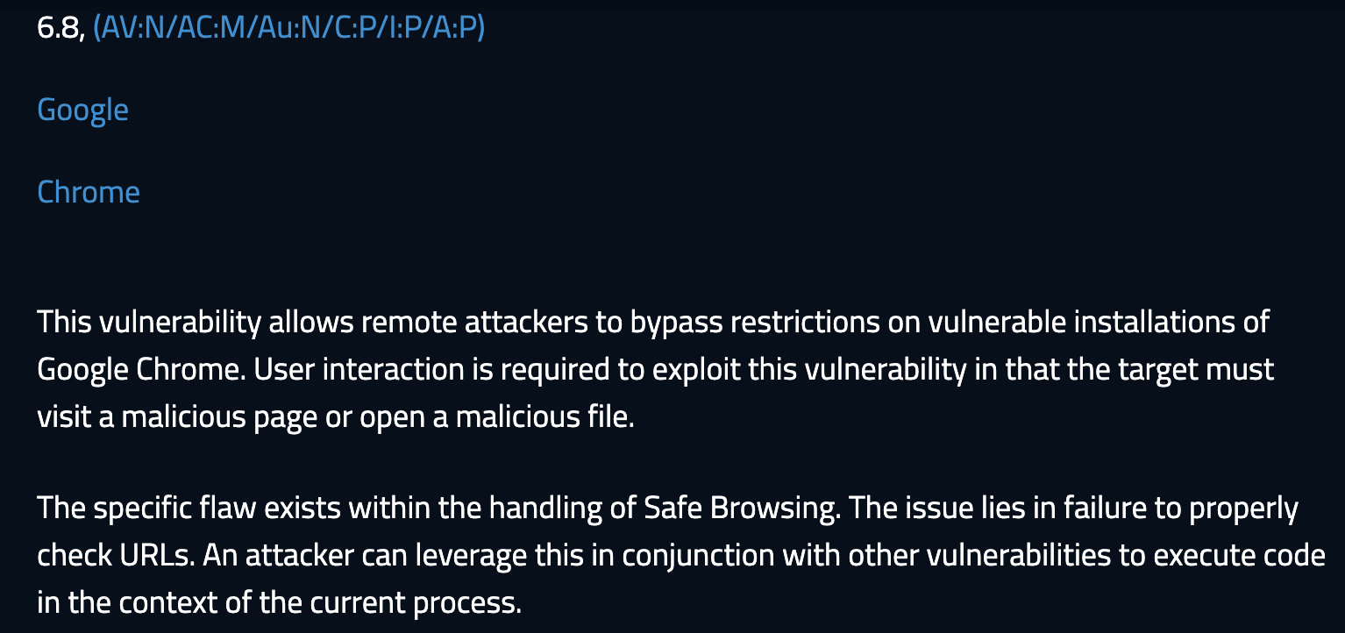
ZDI Example
~6 month to be get public

Slide 29
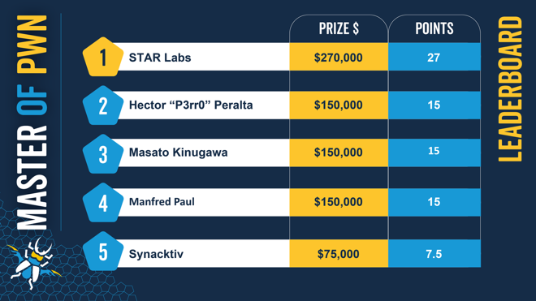
Pwn2Own
ZDI also offers a hacking competition that targets real programs
VMM: VirtualBox, VMWare, Hyper-V
Web browser: Chrome, Edge, Safari, Firefox
Documents processor: MS Office and Adobe PDF
Many other categories, cellphone modems, etc.
All discovered vulnerabilities will be reported to
Vendors via ZDI

Slide 30
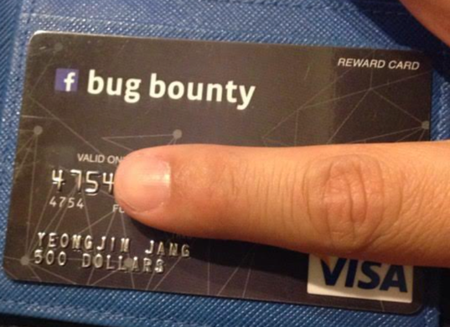
Report to the Vendor
Nowadays, many software vendors offer a ‘bug bounty’ program
Meta: https://m.facebook.com/whitehat/info/
Alphabet (Google): https://bughunters.google.com/about/rules/6625378258649088/google-and-alphabet-vulnerability-reward-program-vrp-rules
Apple: https://security.apple.com/bounty/
MS: https://www.microsoft.com/en-us/msrc/bounty
Discord: https://discord.com/security
Bounty range? Could be from $50 to $250,000, depending on severity

Slide 31
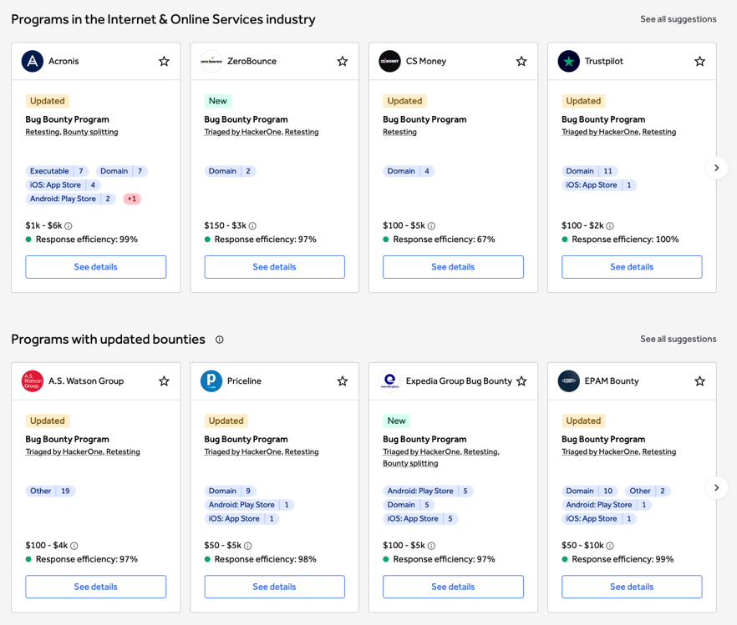
Public Bug Bounty Program
Hacker One
https://hackerone.com/bug-bounty-programs

Slide 32
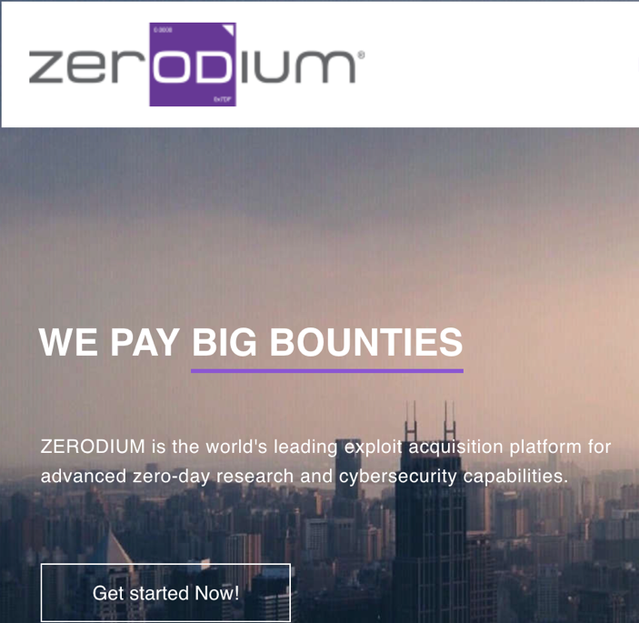
Vulnerability Markets
Zerodium
Big bounties, how big?
A leading exploit acquisition platform
What are advanced zero-day research?
What are cybersecurity capabilities?
Zerodium is for them…

Slide 33
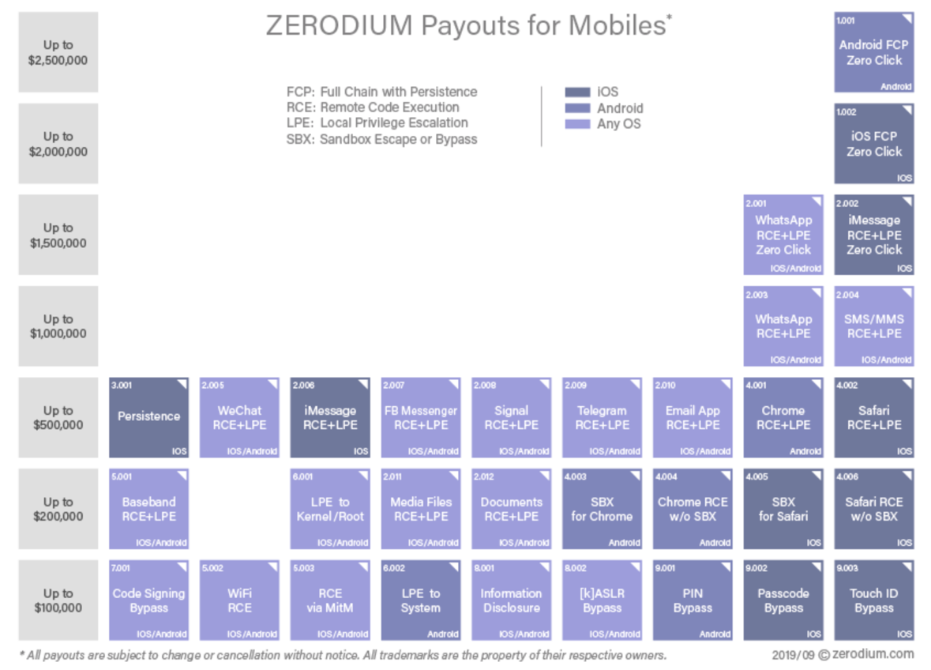
Zerodium Payouts
$2.5M: Android 0-click
$2M: iPhone 0-click
$1.5M: iMessage 0-click
$1.5M: WhatsApp 0-click
$1M: WhatsAPP/SMS…
0-click
No user’s interaction is required for the
successful hack, so users cannot notice
that their device got hacked or not

Slide 34
0-click Attack
1. Suppose an attacker discovered a vulnerability in iMessage
2. Attacker writes an exploit that does:
1) send an attack payload message to the victim
2) the payload, before it triggers the push notification, hacks the device complete, suppress the push notification of the attack message
(The user will never see this…)
3) make the attack persistent (survive after the reboot)
Attack iMessage app, break the application sandbox in iOS, attack iOS kernel to get root, and then, edit the root partition to make the attack persistent…
Usually it requires exploiting multiple vulnerabilities, say, 3~7-ish…

Slide 35
Think About the Business Model
Who will pay that much amount of money?
Vendors? No… then do that in their own bug bounty program
Vendors does not need 0-click exploits; just need the crash input
Who needs 0-click exploits?
Someone who wants to secretly peeping on others
Smartphone
Laptop/Desktop
E-mail/messages
Web accounts, passwords, etc….

Slide 36
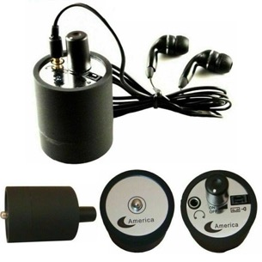
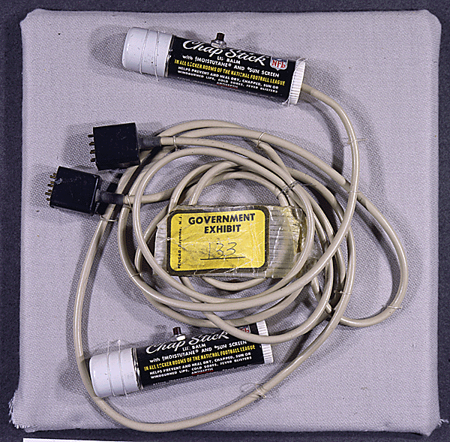

Software Attack Could be a CyberWeapon
A fake scenario
You are a president of the United Counties of Earth, and you will have a huge deal with the Greasy Oil Company tomorrow. But you would like to know the minimum price that the Greasy Oil company accepts.
In 1970

Slide 37
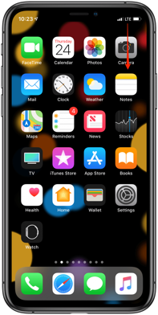


Software Attack Could be a CyberWeapon
In 2022
1. Send a 0-click exploit
2. Leak deal info from the phone
GOC executive
iMessage id: blue9057@gmail.com

Slide 38

Software Attack Could be a CyberWeapon
In 2022
1. Prepare an exploit PDF document as a contract document
2. Send it as a contract docs for tomorrow
3. Leak deal info from the laptop
GOC executive
iMessage id: blue9057@gmail.com

Slide 39



Software Attack Could be a CyberWeapon
In 2022
1. Hack the laptop
2. Hack the phone
3. Connect to VPN
2FA is all OK
4. Hack the server…

Slide 40

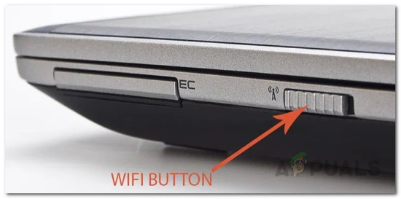
Software Attacks are Powerful
No systems comes w/o vulnerabilities
I have a belief that all systems can be hacked (for now)
That’s why my domain name is unexploitable.systems
To assess the threat of software attack, think like
Anything connected to the Internet can be controlled by hackers
Anything receive inputs without physical touch can be controlled by hackers
Typing keyboards, mouse, etc…

Slide 41
Not Just for That…
We are living in the era of Ubiquitous and Pervasive Computing
Computers are everywhere
Smartphone – GPS, gyrometer, camera, mic, speaker, Internet, etc…
Smartwatch – GPS, gyrometer, laser to measure heartrate, breathe, sleep, Internet, etc…
Smartspeaker – Mic, speaker, Internet, etc…
Smartpoweroutlet – capability to monitor/manipulate power, Internet, etc..

Slide 42

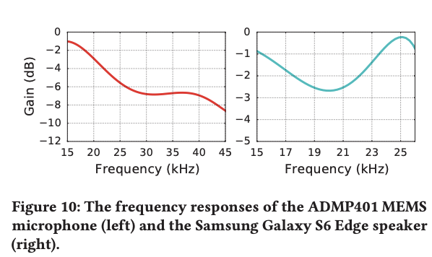
Totally Possible Attack Scenario
1. Hack a smartphone of a user
2. Record voice all time in background; you can turn a smartphone as an eavesdropping bug
3. When the user gets to home (locate via GPS on Smartphone), play an ultrasonic sound to command Smartspeaker
Alexa, order 100 copies of Yeongjin’s security program from Amazon!
FYI, human ear can hear audio in range of
20Hz—20KHz

Slide 43
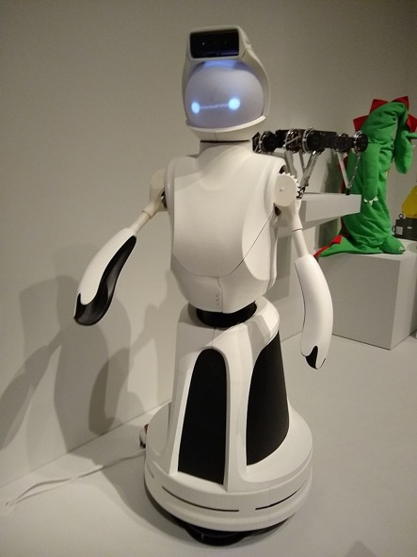

Totally Possible Attack Scenario
What if you can hack a robot, or a drone?
Software attack -> Physical attack

Slide 44
Summary
Compiler options can detect/prevent software attacks
Use them, and don’t ignore their warnings and reports
There are several ways to responsibly disclose vulnerabilities
Now community give rewards for finding/fixing their problems
Many companies opens bug bounty program -> report vulns here!!
If not, we can go through coordinated vulnerability disclosure (e.g., via ZDI)
In the ubiquitous computing era, software attacks are serious matter. There is a huge cyberweapon market under the hood
Thursday, we will learn about malware, for how such weapons could be used to launch a targeted attack (Nuclear power plant) and a mass attack (DDOS and ransomware)

